Slide 1

Dr. NGP INSTITUTE OF TECHNOLOGY
22UAD801- PROJECT WORK
Review 2
AI-POWERED BREED IDENTIFICATION SYSTEM FOR DAIRY CATTLE AND BUFFALOES
Presented by,
ARUNIKA G (710722243005)
NAVYA N J (710722243034)
RITHANYA V (710722243040)
Under the Guidance of
Dr. I. Devi B.E., M.E., PhD.,
Assistant Professor (Sr.Gr.)

Slide 2
Objective
Dr. NGP INSTITUTE OF TECHNOLOGY
Velalar College of Engineering and Technology
The objective of this project is to design and develop an AI-powered breed identification system for dairy cattle and buffaloes using image-based deep learning techniques. The system aims to accurately classify indigenous breeds under real-world farm conditions and improve the quality of livestock data used for breeding, insurance, and government schemes.
Specific Objectives:
To automate breed identification using image-based analysis.
To perform automated breed identification using deep learning based image classification techniques
To provide a practical and user-friendly solution suitable for real-time usage.

Slide 3
Abstract
Dr. NGP INSTITUTE OF TECHNOLOGY
Velalar College of Engineering and Technology
India is home to 50+ recognized cattle and buffalo breeds, each with unique genetic, productivity, and disease-resistance traits. Accurate breed identification is vital for breeding, nutrition planning, and disease control. Currently, manual identification by FLWs leads to frequent misclassification, resulting in poor-quality data in national livestock databases.
This project proposes a deep learning–based breed identification system using image-based analysis, which will detect and classify breeds from captured images.
Suggest accurate breed names in real time.
Enhance reliability of government records and assist in effective policy-making
11-Feb-26
Department of AI&DS
3

Slide 4
Dr. NGP INSTITUTE OF TECHNOLOGY
Velalar College of Engineering and Technology
Problem Statement
Manual livestock breed identification:
Depends heavily on human expertise
Leads to misclassification
Causes incorrect livestock database entries
Affects government schemes, insurance, and breeding strategies
There is no scalable, automated, and accurate system available for breed identification in real-time field conditions.
11-Feb-26
11-Feb-26
Department of AI&DS
Department of AI&DS
4
4

Slide 5
Dr. NGP INSTITUTE OF TECHNOLOGY
LITERATURE SURVEY 1
Image-Based Breed Recognition of Indian Cattle and Buffaloes Using YOLOv12 and Roboflow Cloud Platform (Year: 2025) Authors: Aashish Chauhan, Ajit Kumar Gupta, Garvit Paliwal, Gautam Singh, Harshit Singh, Dr. Umesh Dwivedi
This study presents BreedVision, an AI-powered web system for automated cattle and buffalo breed recognition. The approach uses YOLOv12 object detection trained on 3,683 annotated images covering 15 major Indian breeds.
Real-time classification is achieved by integrating ReactJS frontend with a Python Flask backend and a Roboflow cloud inference engine
11-Feb-26
5

Slide 6
Dr. NGP INSTITUTE OF TECHNOLOGY
LITERATURE SURVEY 2
Development of a Lightweight Deep Learning Model for the Identification and Classification of Indigenous Cattle Breeds (Year: 2025) Authors: Shruti Arya, Indu Devi, Divyanshu Singh Tomar, Man Singh, Radhika Warhade, Anshul Gautam, T. K. Mohanty
This research focuses on differentiating phenotypically similar indigenous cattle breeds (e.g., Tharparkar and Hariana) using a deep learning-based segmentation and classification pipeline. This work highlights the challenge of similar visual appearance and the need for segmentation before classification in breed recognition.
11-Feb-26
Department of AI&DS
6

Slide 7
Dr. NGP INSTITUTE OF TECHNOLOGY
LITERATURE SURVEY 3
Buffalo Identification in Mixed-Species Environments: A Comparative Deep Learning Approach Using ResNet50 and EfficientNetB3 (Year: 2025) Authors: Nagaraj Naik (Manipal Institute of Technology), Ramu S. (Siddaganga Institute of Technology)
This study compares the performance of ResNet50 and EfficientNetB3 for visual buffalo identification in mixed species scenarios. By curating a balanced dataset with multiple classes (buffalo, elephant, rhino, zebra), the research evaluates how CNN architectures distinguish buffaloes from other large mammals, demonstrating the effectiveness of deeper networks in complex visual classification challenges
11-Feb-26
Department of AI&DS
7

Slide 8
Dr. NGP INSTITUTE OF TECHNOLOGY
LITERATURE SURVEY 4
Ensemble Learning Algorithm for Cattle Breed Identification Using Computer Vision Techniques (Year: 2024) Authors: Vijayalakshmi A, P. Shanmugavadivu, S. Vijayalakshmi, Shreyansh Padarha, Sivaranjani R
This research proposes an ensemble learning approach for cattle breed identification by combining multiple computer vision techniques including CNN, YOLO object detection, Canny edge detection, k-means segmentation, and grayscale imaging. The ensemble classifier uses a voting mechanism to improve robustness against obscured features and environmental noise, suggesting that hybrid methods can address limitations of individual models.
11-Feb-26
8

Slide 9
Dr. NGP INSTITUTE OF TECHNOLOGY
Existing System
In India, cattle and buffalo breed identification is mostly carried out through manual visual inspection by Field Level Workers (FLWs).
Breed identification is based on physical characteristics such as coat color, body structure, horn shape, and size.
The process depends heavily on human expertise and experience, making it inconsistent across regions.
Some AI-based research systems and online breed classifier applications have been developed, but they are mostly limited to experimental or small-scale usage.
11-Feb-26
11-Feb-26
Department of AI&DS
9
9

Slide 10
Dr. NGP INSTITUTE OF TECHNOLOGY
Proposed System
The proposed system is an AI-powered breed identification system for dairy cattle and buffaloes that uses a deep learning–based image classification model for breed identification
Key Features / Improvements:
Utilizes deep learning techniques for automatic feature extraction and breed classification for deep feature learning and better discrimination between visually similar breeds.
Focuses on classification-oriented modeling rather than detection-first approaches.
Robust performance under real-world farm conditions, including variations in lighting and background.
Designed for scalable deployment, with future support for offline and edge inference.
Can be integrated with livestock management and government breed databases for practical use.
11-Feb-26
11-Feb-26
11-Feb-26
Department of AI&DS
Department of AI&DS
10
10
10

Slide 11
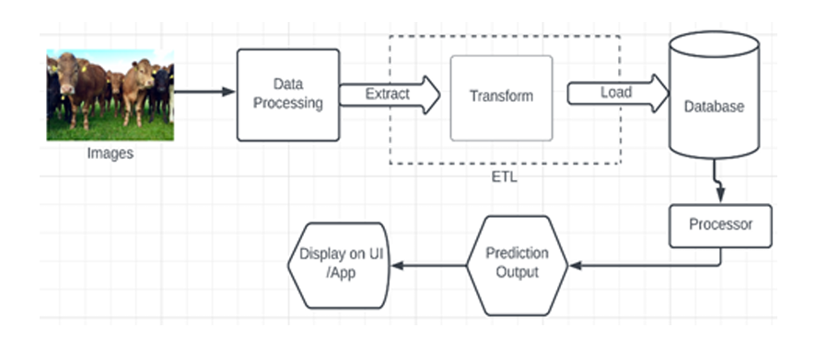
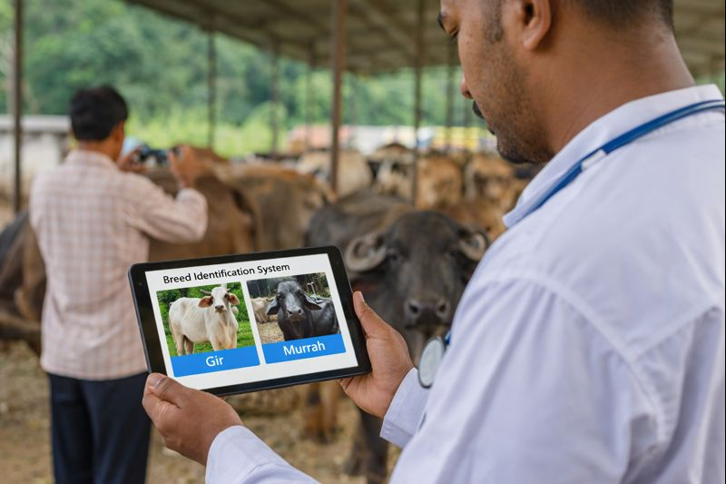
Dr. NGP INSTITUTE OF TECHNOLOGY
Proposed Architecture Block diagram
11-Feb-26
Department of AI&DS
11

Slide 12
Dr. NGP INSTITUTE OF TECHNOLOGY
Modules
Image Acquisition Module
Image Preprocessing Module
Feature Extraction Module (Deep Learning Model)
Breed Classification Module (Image-based Classifier)
Prediction & Result Analysis Module
User Interface & Deployment Module

Slide 13
Dr. NGP INSTITUTE OF TECHNOLOGY
Module Description
1) Image Acquisition Module
Manages the capture or upload of cattle and buffalo images from mobile devices or cameras under real-time farm conditions.
Key Features: Real-time image capture, support for multiple image formats, adaptability to varying lighting and angles.
2) Image Preprocessing Module
Enhances and standardizes the captured images to make them suitable for deep learning model input.
Key Features: Image resizing, noise reduction, normalization, improved image quality for better accuracy.

Slide 14
Dr. NGP INSTITUTE OF TECHNOLOGY
Module Description
3) Feature Extraction Module (CNN)
Automatically extracts meaningful visual features from images using convolutional neural networks.
Key Features: Automatic feature learning, extraction of texture and shape patterns, elimination of manual feature engineering.
4) Breed Classification Module
Classifies cattle and buffalo breeds using a deep Residual Neural Network architecture.
Key Features: Residual learning, deep feature refinement, high accuracy for visually similar breeds.
11-Feb-26
Department of AI&DS
14

Slide 15
Dr. NGP INSTITUTE OF TECHNOLOGY
Module Description
5) Prediction & Result Analysis Module
Generates the final breed prediction along with confidence scores.
Key Features: Breed name prediction, probability score output, handling of uncertain predictions.
6) User Interface & Deployment Module
Provides an interactive interface for users to upload images and view results, and supports system deployment.
Key Features: User-friendly interface, real-time results display, scalable web/mobile deployment support.
11-Feb-26
11-Feb-26
Department of AI&DS
Department of AI&DS
15
15

Slide 16
Dr. NGP INSTITUTE OF TECHNOLOGY
ALGORITHMS USED
YOLO-Based Deep Learning Model (CNN Architecture) Performs real-time image detection and multiclass classification of Indian bovine breeds. Extracts spatial features using convolutional layers and predicts breed labels with confidence scores in a single forward pass.
Multiclass Image Classification Algorithm Learns discriminative visual features from labeled bovine datasets to classify multiple Indian cattle breeds. Handles variations in orientation, illumination, and background for reliable prediction.
Retrieval-Augmented Generation (RAG) Combines document retrieval with language generation to support an intelligent chatbot. Relevant breed-related information is retrieved from a knowledge base and used to generate accurate, context-aware responses.
11-Feb-26
11-Feb-26
11-Feb-26
Department of AI&DS
Department of AI&DS
Department of AI&DS
16
16
16

Slide 17
Dr. NGP INSTITUTE OF TECHNOLOGY
ALGORITHMS USED
4. FAISS-Based Vector Similarity Search Enables efficient indexing and retrieval of high-dimensional embeddings. Supports fast and consistent retrieval of relevant documents for chatbot query resolution.
5. Large Language Model (LLM) with NLP Techniques Processes natural language queries and generates human-readable explanations about Indian bovine breeds, improving user interaction, interpretability, and learning experience.
11-Feb-26
11-Feb-26
11-Feb-26
Department of AI&DS
Department of AI&DS
Department of AI&DS
17
17
17

Slide 18
System Requirements
Dr. NGP INSTITUTE OF TECHNOLOGY
Hardware
Software
Processor (CPU) capable of running deep learning inference
Minimum 8 GB RAM to load model and process image data
Storage to maintain dataset and trained model files
Python programming language
Deep learning framework
(PyTorch)
FastAPI for backend processing
OpenCV / PIL for image preprocessing
HTML, CSS, JavaScript for user interface
11-Feb-26
Department of AI&DS
18

Slide 19
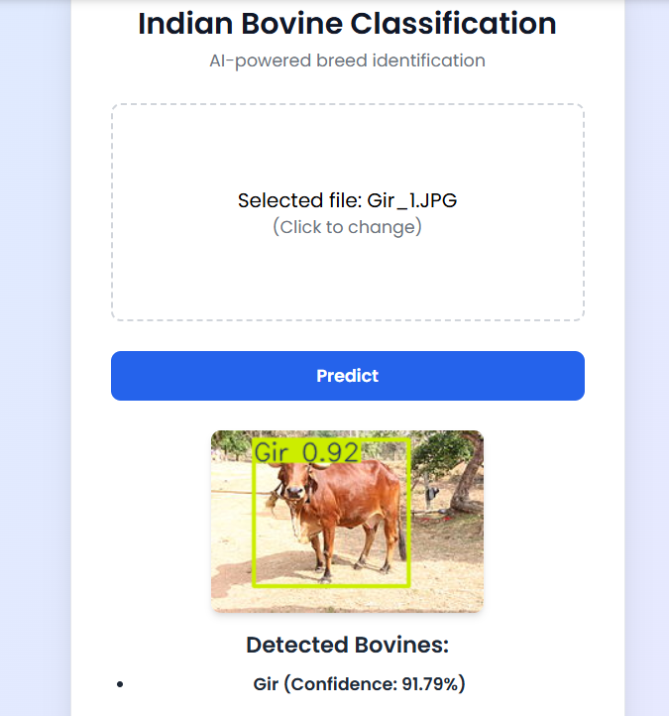
Dr. NGP INSTITUTE OF TECHNOLOGY
Output Screenshot
11-Feb-26
11-Feb-26
11-Feb-26
Department of AI&DS
Department of AI&DS
Department of AI&DS
19
19
19

Slide 20
Dr. NGP INSTITUTE OF TECHNOLOGY
Dr. NGP INSTITUTE OF TECHNOLOGY
Paper Status
14th International Conference on Contemporary Engineering and Technology – ICCET 2026
Paper Status: (ACCEPTED)
Paper ID: ICCET260592
Paper Title: AI-Driven Cattle Breed Identification and Livestock Monitoring for the Indian Agricultural Ecosystem
11-Feb-26
Department of AI&DS
20

Slide 21
Dr. NGP INSTITUTE OF TECHNOLOGY
Future Enhancement
Integration with Bharat Pashudhan App To support real-time breed validation during livestock registration by Field Level Workers.
Expansion of Breed Dataset Include more indigenous and crossbred cattle and buffalo breeds to improve system accuracy.
Mobile Application Development Enable field-level usage through a mobile app for easy image capture and prediction.
11-Feb-26
11-Feb-26
Department of AI&DS
Department of AI&DS
21
21

Slide 22
Dr. NGP INSTITUTE OF TECHNOLOGY
Conclusion
The project demonstrates the effective use of deep learning and computer vision for automated breed identification of dairy cattle and buffaloes.
The AI-based system reduces human dependency and improves accuracy by analyzing visual and morphological features.
The web-based implementation enables real-time predictions with confidence scores, enhancing usability and decision-making.
Overall, the system validates the feasibility of AI-assisted livestock management and supports the digital transformation of the agricultural sector.
11-Feb-26
11-Feb-26
Department of AI&DS
Department of AI&DS
22
22

Slide 23
Dr. NGP INSTITUTE OF TECHNOLOGY
References
A. Sharma et al., “Deep Learning Models for Livestock Breed Identification,” IEEE Access, vol. 11, pp. 12345–12356, 2023.
Ministry of Fisheries, Animal Husbandry & Dairying, Bharat Pashudhan App, Govt. of India, 2022.
R. Singh and K. Mehta, “Applications of Computer Vision in Precision Livestock Farming,” Computers and Electronics in Agriculture, vol. 198, 2022.

Slide 24
Dr. NGP INSTITUTE OF TECHNOLOGY
THANK YOU
11-Feb-26
11-Feb-26
24
24

